Slide 1
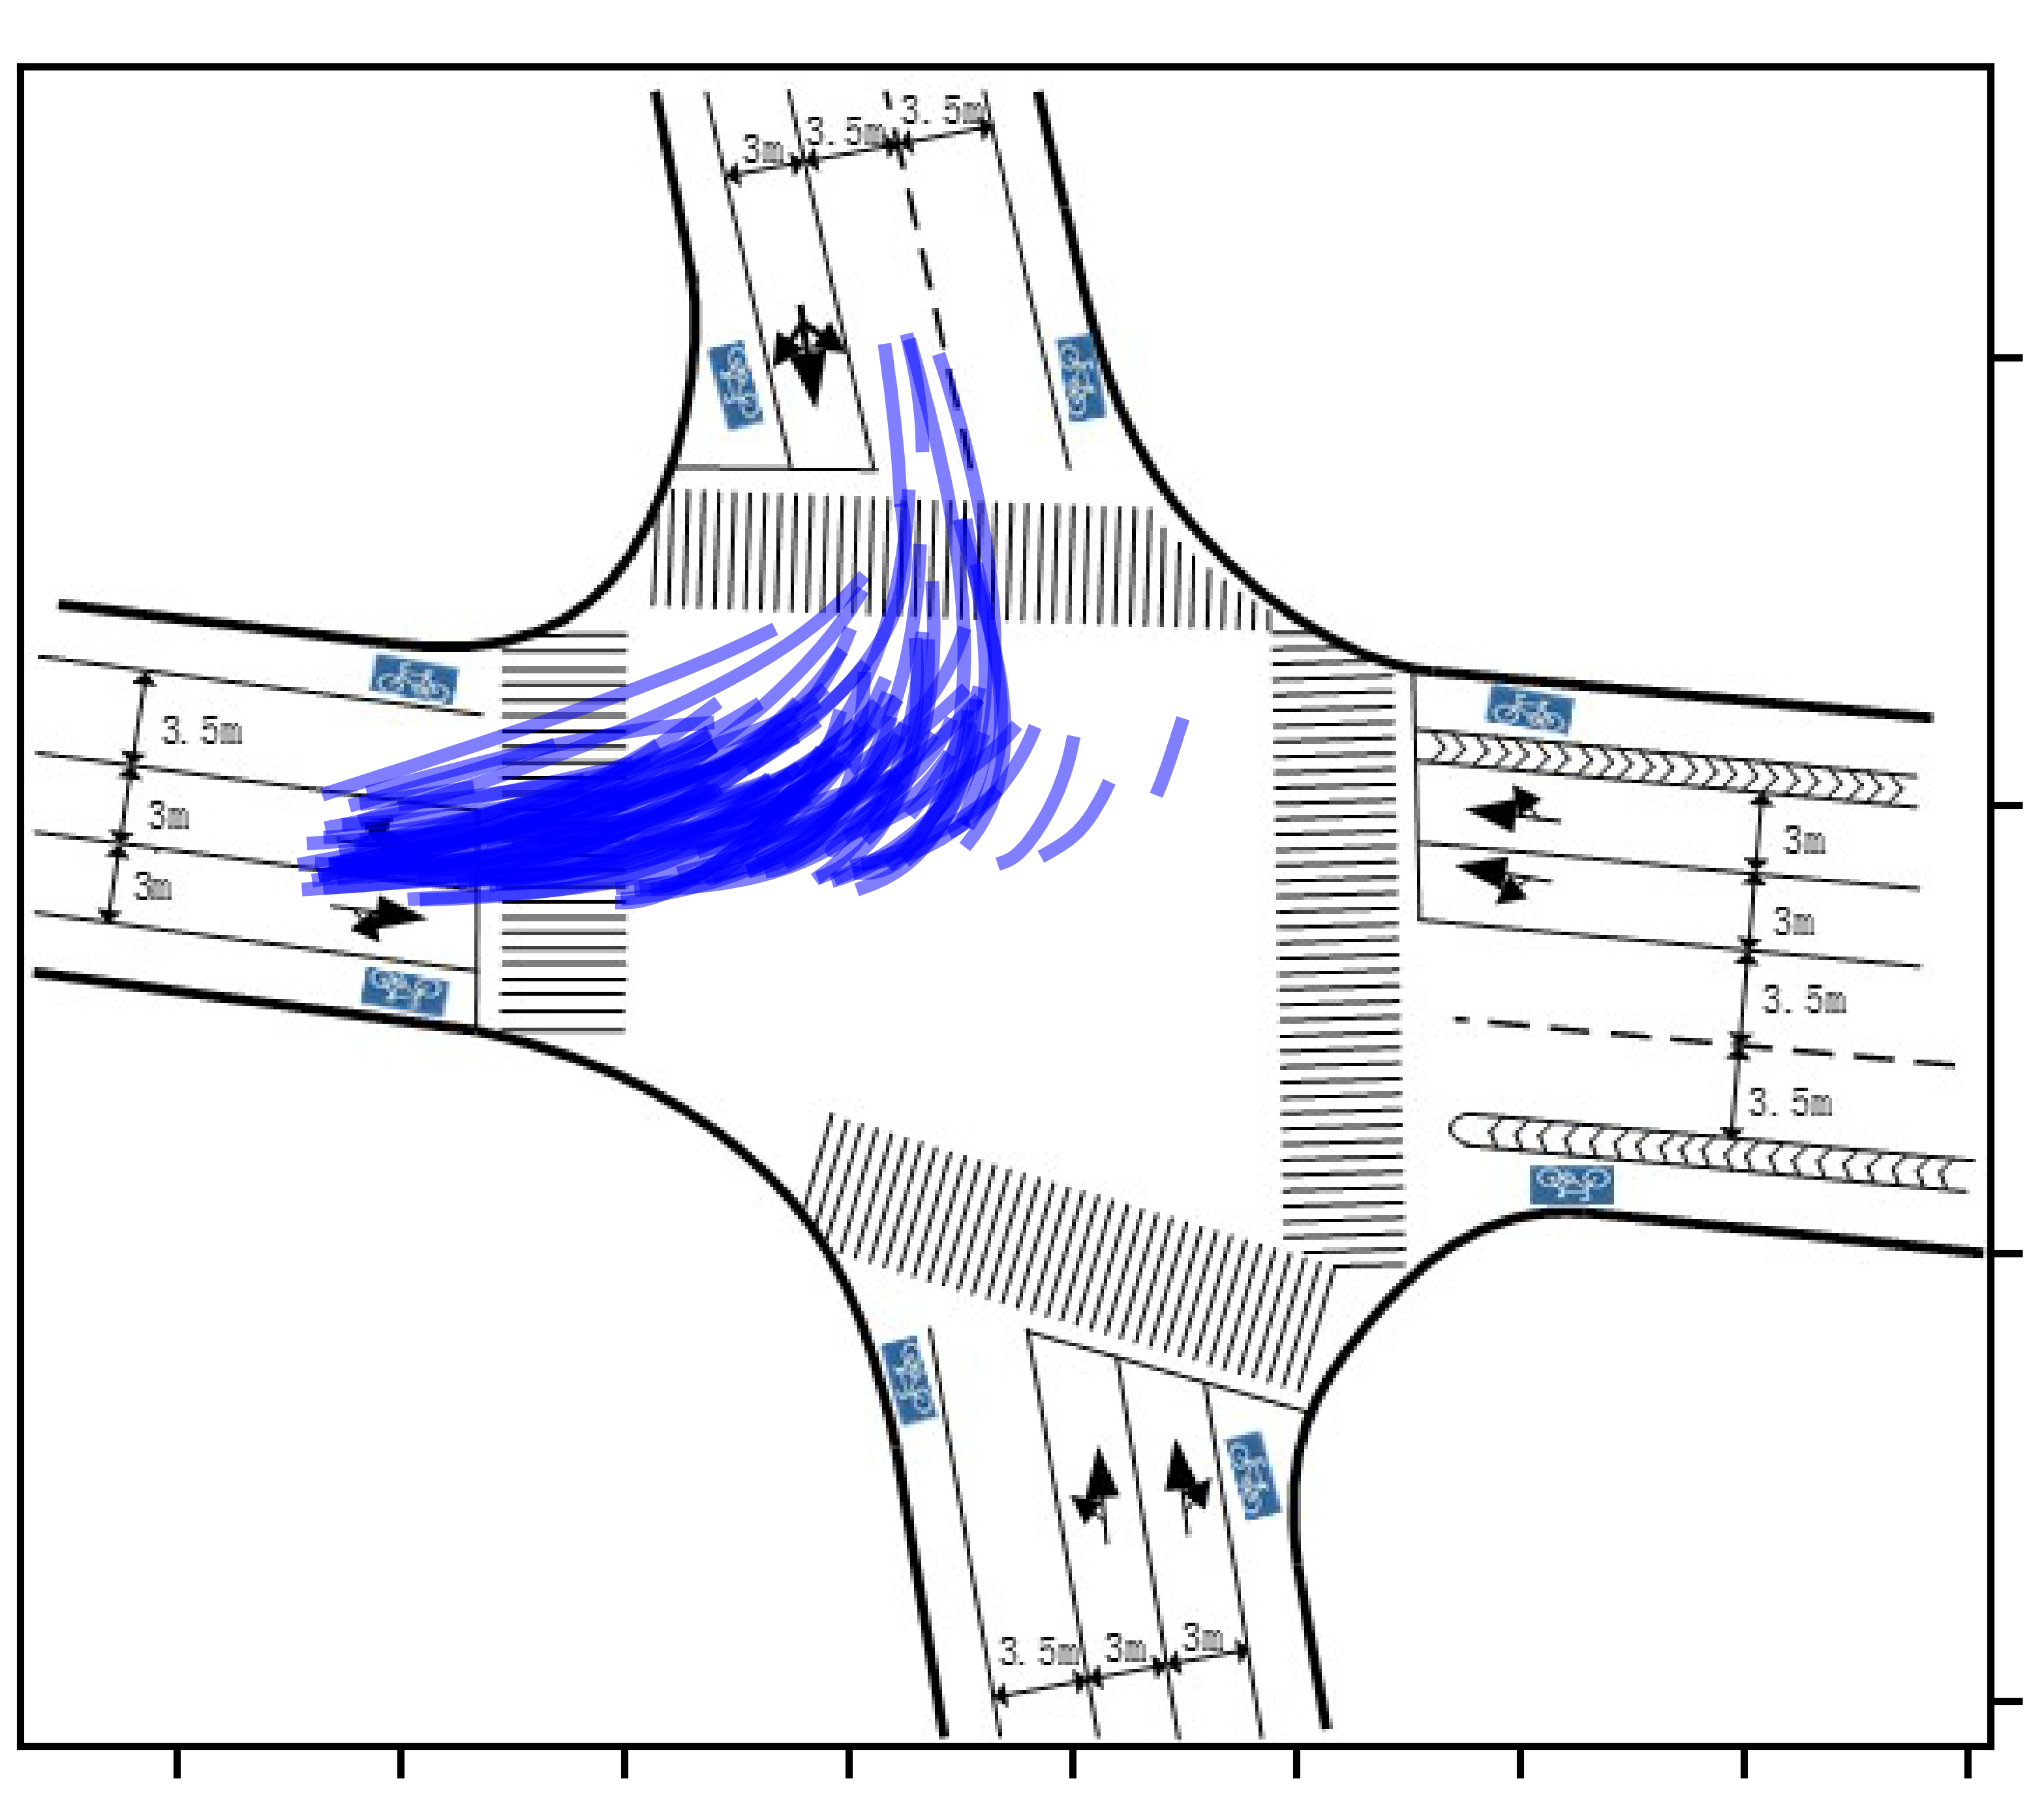
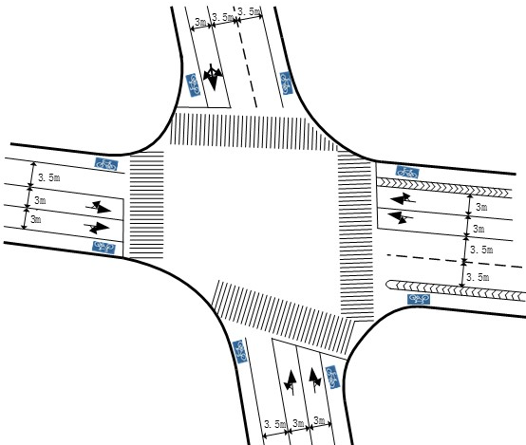
40
20
0
-20
50 40 30 20 10 0 -10 -20 -30

